Slide 1



ML-based Visualization Recommendation: Learning to Recommend Visualizations from Data
Authors: Xin Qian, Ryan A. Rossi, Fan Du, Sungchul Kim, Eunyee Koh, Sana Malik, Tak Yeon Lee, Joel Chan
Team Members:
Arihant Dugar (B00917961) ar968345@dal.ca
Abhinav Acharya Tirumala Vinjamuri (B00929073) ab806657@dal.ca

Slide 2

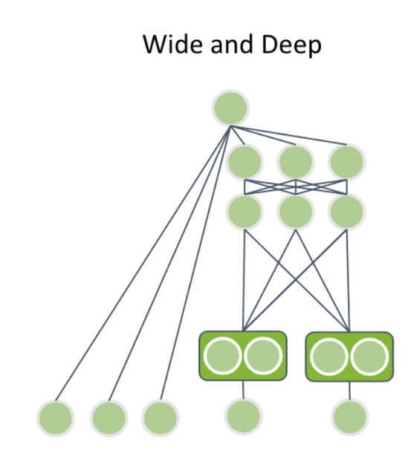

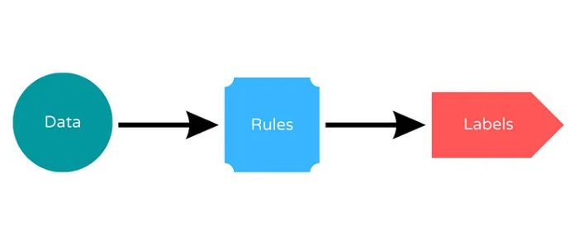
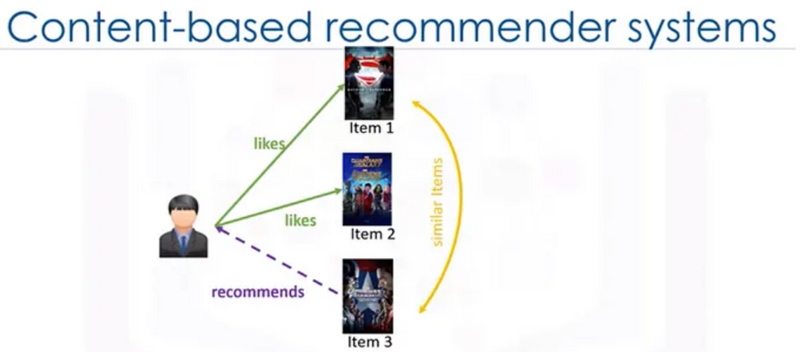
Introduction
Rule-Based Recommender Algorithms
Wide and Deep Learning
Content-based recommendation model
Rule Based Learning Model
1

Slide 3
Problems Addressed
Problem: Existing visualization recommendation systems are inefficient and ineffective
Approach: Machine learning-based method for visualization recommendation using wide-and-deep learning
Goal: To capture the latent characteristics of datasets and visualizations, and to generate, score, and recommend useful visualizations
Evaluation: Modified nDCG metric and user study to measure the effectiveness and utility of the recommended visualizations
Model: Wide and Deep Learning Content-Based Visualization Recommendation Model.
Note:
nDCG - normalized Discounted Cumulative Gain
2

Slide 4
Research Paper Questions
How to automatically generate, score, and recommend useful visualizations from a large corpus of datasets and visualizations?
How to learn a general and data-driven model for visualization recommendation that can adapt to new datasets and user preferences?
How to evaluate the effectiveness and utility of the recommended visualizations using quantitative and qualitative methods?
How to leverage machine learning techniques such as wide-and-deep learning to capture the latent characteristics of datasets and visualizations?
3

Slide 5
Relevance
 | Research Paper | Our Project
Focus | Recommendations | Recommendations & Analysis
Dataset | Large corpus of datasets | Spotify Music Dataset
Solution | Recommend useful and effective visualizations for unseen data. | Interactive music-feature, genre exploration, and User matching through effective and useful visualizations.
Inference | Providing insight to users | Providing insight to users
4

Slide 6
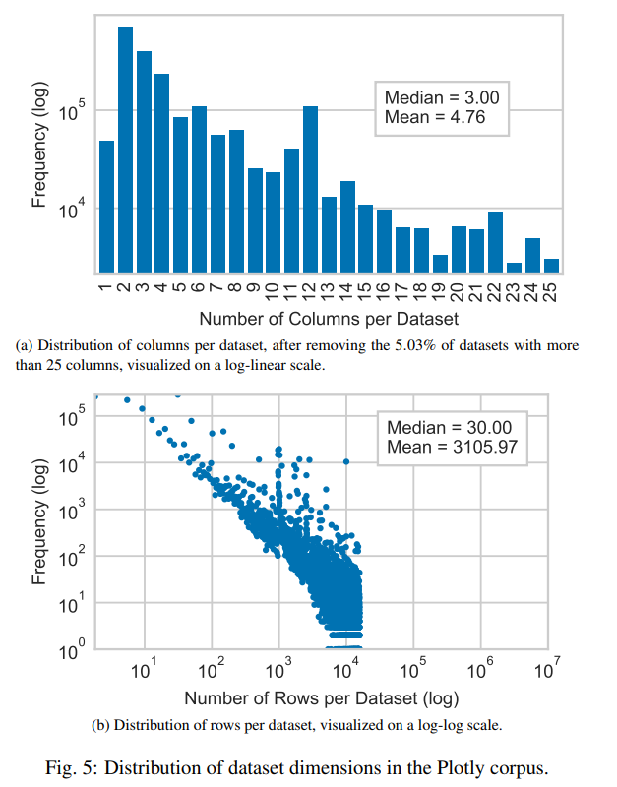
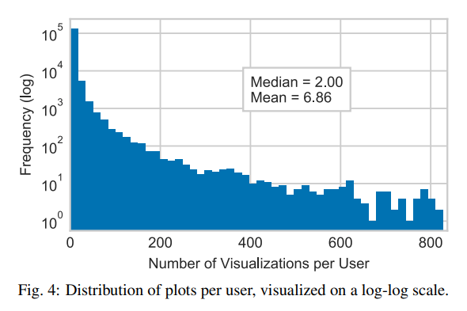
Dataset
Training corpus of 1K datasets (and their visualizations) from the Plot.ly corpus
12 attributes each
Source: https://chart-studio.plotly.com/feed/#/
5

Slide 7
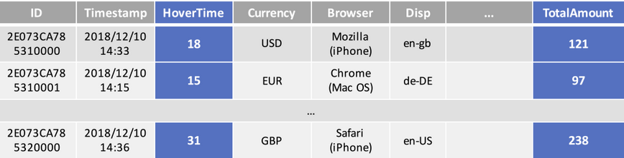



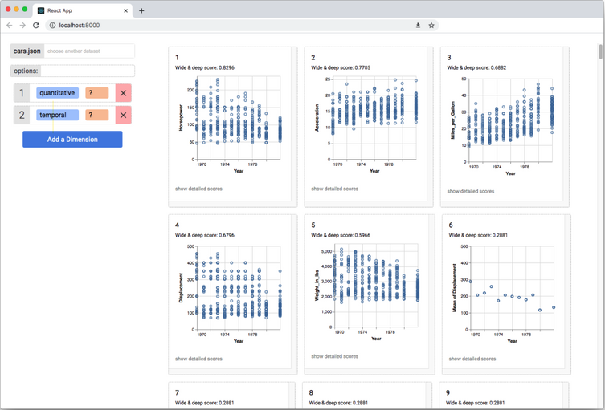
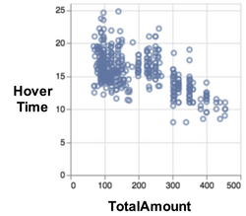
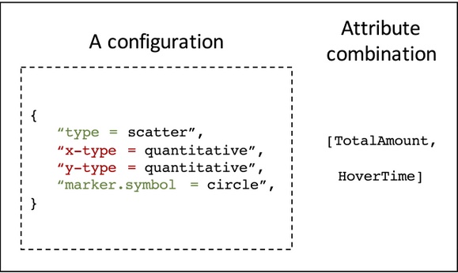
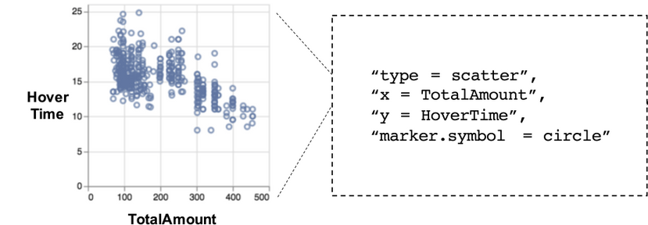
Solutions
Similar unseen dataset corpus
Model
Training Dataset Corpus
Recommended visualizations dashboard
Positive Visualization
Visualizations on the training dataset
6

Slide 8
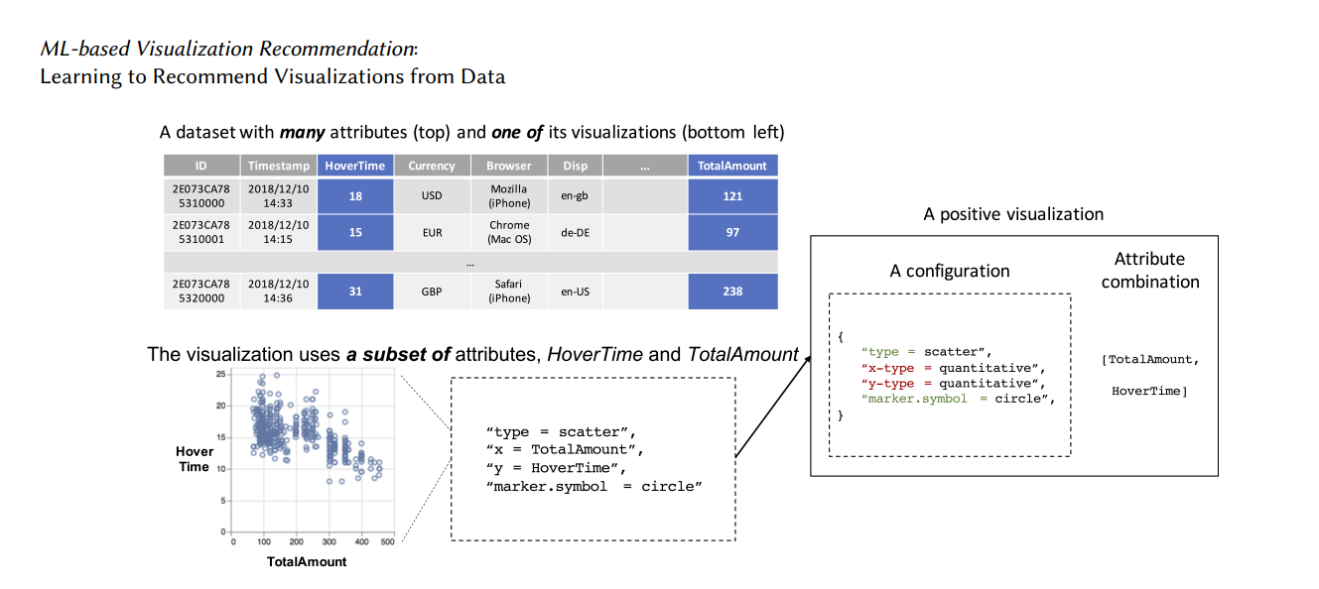
Visualization Data Extraction Process
7

Slide 9
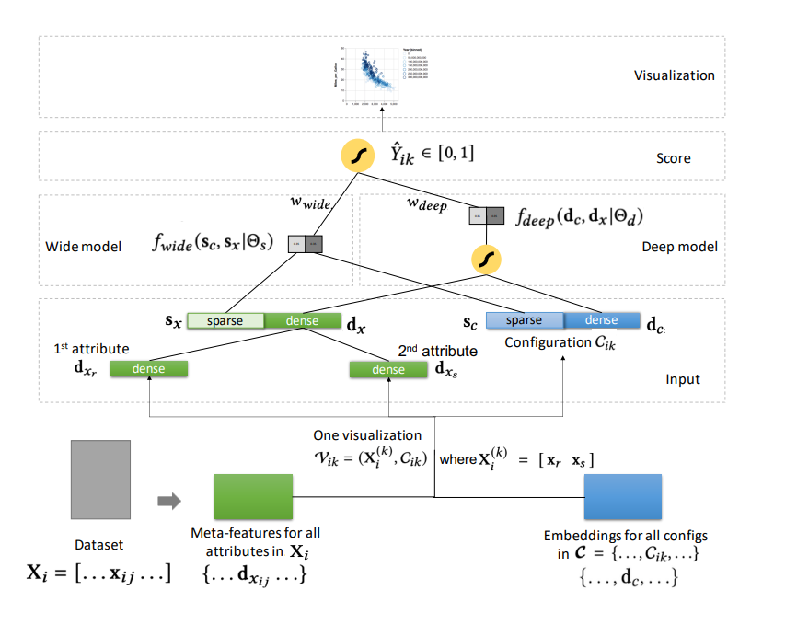
Model Design
8

Slide 10
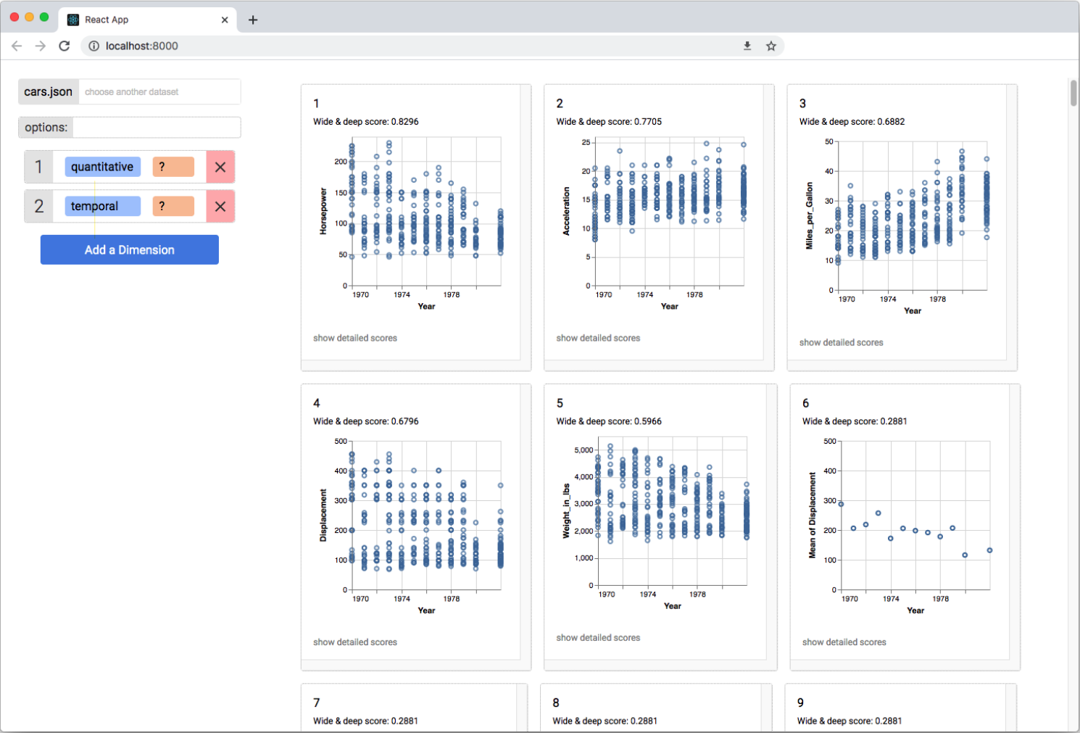
Dashboard
9

Slide 11
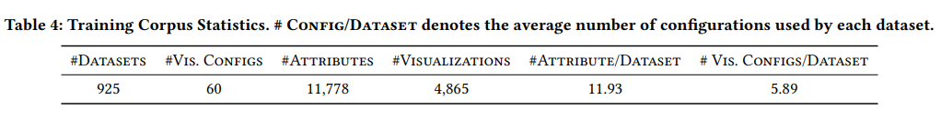
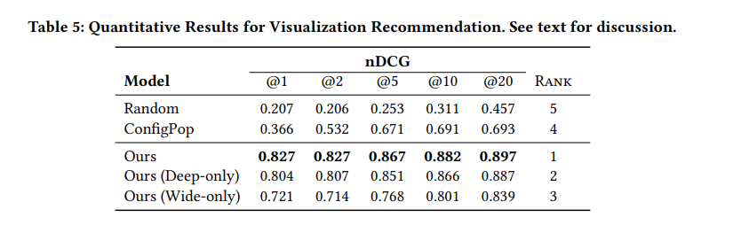
Evaluation - Quantitative Analysis
The modified normalized Discounted Cumulative Gain (nDCG) at k ∈ {1, 2, 5, 10, 20} for the different top-k visualization recommendations (nDCG@k).
10

Slide 12
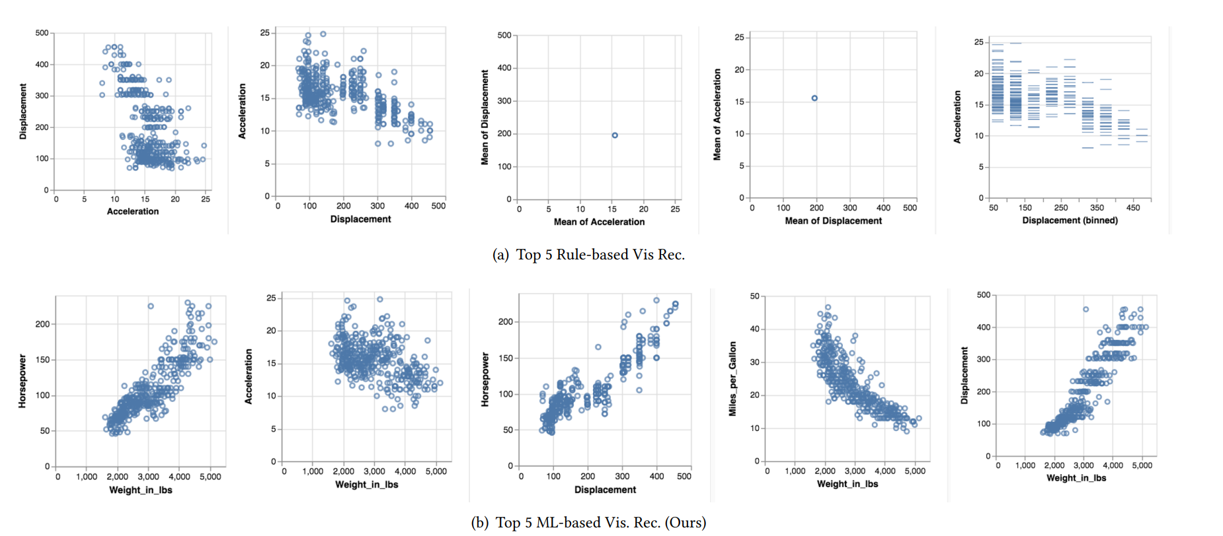
Evaluation - User Study
11

Slide 13
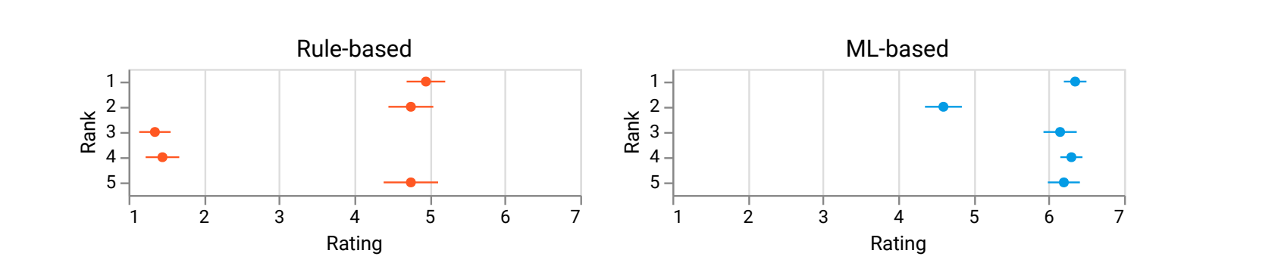
Evaluation - User Study - Expert Rankings
12

Slide 14
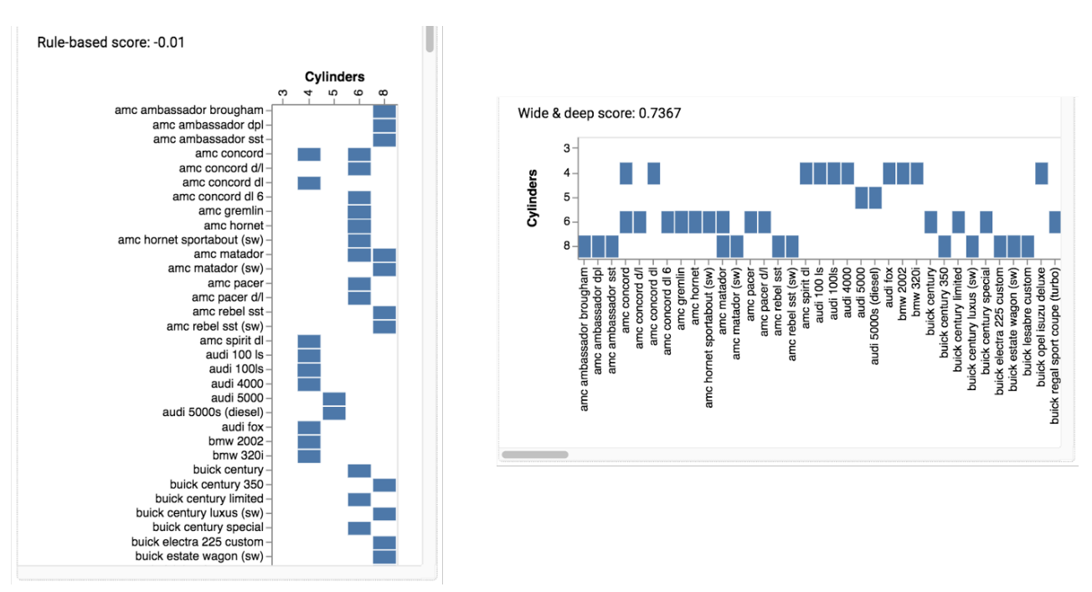
Evaluation - Qualitative Analysis - Learning to place attributes like an expert
13

Slide 15
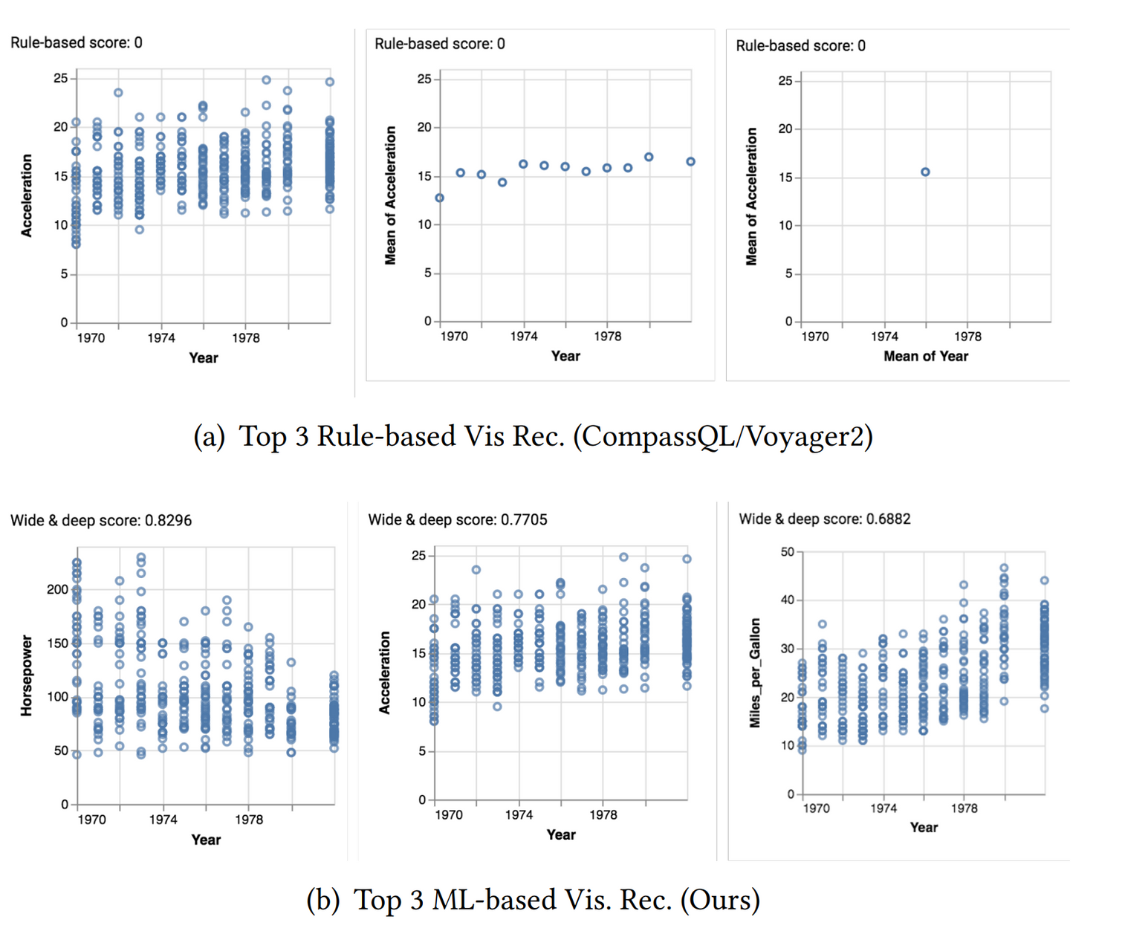
Evaluation - Qualitative Analysis - Tie-Breaking Issue
14

Slide 16
Limitations
No interpretability or explainability of the model.
No consideration of user preferences, tasks, or goals.
Exponential visualization and negative visualization space.
High computational cost and complexity.
Information loss at the bottom of the recommendation list.
No domain generalizability / extensibility.
15

Slide 17
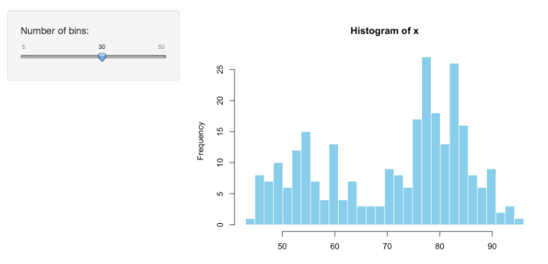
Future Works
Feedback learning for evaluation and relevance
User control for complexity adjustment
Model optimization for space and time
User choice for visualization selection
Knowledge base for domain generalization
16

Slide 18
Thank You
17

Slide 19
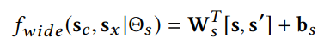
Appendix - Wide Model
A linear model that uses sparse features of attribute combination and configuration to capture frequent patterns that lead to effective visualizations. The wide score is computed as:
where s and s′ are the original and cross-product sparse features, Θs​ is the set of parameters, and σ is the sigmoid function.
The goal of leveraging sparse features is to capture any occurrence of feature-pairs that commonly lead to effective visualizations in the training corpus.
18

Slide 20
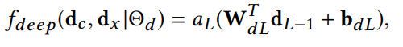
Appendix - Deep Model
A non-linear model that uses dense features of attribute combination and configuration to generalize to less common patterns that may also lead to effective visualizations. The deep score is computed as
where dc​ and dx​ are the dense features of configuration and attribute combination, Θd​ is the set of parameters, dL​ is the output of the last hidden layer, and σ is the sigmoid function.
19

Slide 21
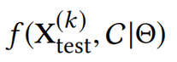
Appendix - Wide and Deep Model
A hybrid model that combines the wide and deep models to leverage both sparse and dense features. The final score is computed as:
where wwide​ and wdeep​ are the weights for the wide and deep scores, and Θ is the entire set of parameters.
The entire set of parameters Θ, including Θs , Θd , wwide and wdeep are learned through backward propagation
20

Slide 22
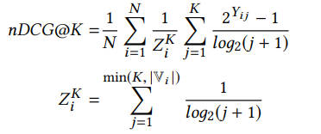
Appendix - nDCG
A normalized discounted cumulative gain (nDCG), which is a metric to evaluate the quality of a ranking of items based on their relevance scores.
A modified nDCG is computed as follows:
nDCG is a popular metric for evaluating information retrieval systems, such as search engines, recommender systems, and question answering systems. It is especially useful when the relevance of items is graded rather than binary, and when the order of items matters.
A good end-to-end learning-based visualization recomemender system must be able to give up some of its performance at the bottom of the list of recommended visualizations to improve the performance at the top.
21

